Slide 1


Data Science Fundamentals
2
+
College of Computer Science And Information Technology
2
+
Session 1
Introduction

Slide 2
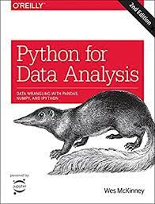
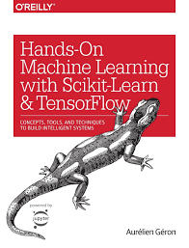
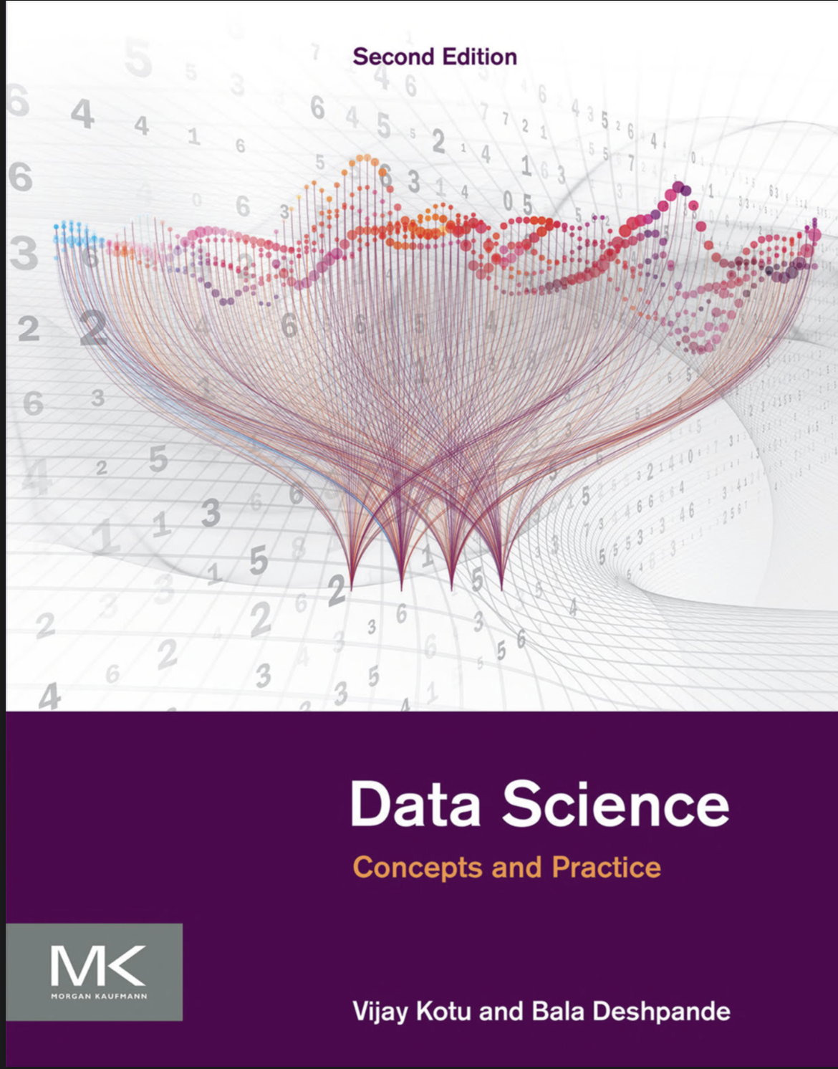
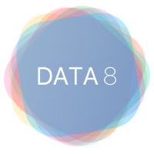
Course Book
The main textBook
Hands-On Machine Learning with Scikit-Learn and TensorFlow: Concepts, Tools, and Techniques to Build Intelligent Systems 1st Edition
Author: Aurelien Geron
Available: https://bcebakhtiyarpur.org/wp-content/uploads/2020/03/file_5e748501c810d.pdf
Python for Data Analysis: Data Wrangling with Pandas, NumPy, and IPython 2nd Edition
Author: Wes McKinney
Available online as Pdf (https://bedford-computing.co.uk/learning/wp-content/uploads/2015/10/Python-for-Data-Analysis.pdf)

Slide 3
Data Scientist
Future and Income
Big Data Engineer
Median Salary: $151,300
Data Architect
Median Salary: $137,000
Data Modeler
Median Salary: $130,000
Data Scientist Median Salary: $122,000
Database Developer Median Salary: $109,300

Slide 4
What is Data Science? is a collection of techniques used to extract value from data
Artificial Intelligent
Linguistics Vision Language Synthesis Robotics Sensor Planning
Machine Learning
RF SVM DT KNN LR LC Linear Regression Naive bayes
Data Science
Text Mining Statistics
Visualization
Time Serious Forecasting
Data Analysis
Data Transformation and Preprocessing

Slide 5
Definition of data science
Data Science is a collection of techniques used to extract value from data to learn about the world
Data science is a multidisciplinary field that combines techniques from statistics, computer science, and domain-specific knowledge to extract insights and knowledge from data.
It involves collecting, cleaning, and analyzing data to uncover patterns, make predictions, and support decision-making.
Data scientists use various tools and techniques, including data mining, machine learning, and data visualization, to solve complex problems and gain a deeper understanding of data.
Data science is widely applied in fields like business, healthcare, finance, and many others to inform data-driven decisions and solutions.

Slide 6
How Data Science Works?
Problem Statement
Data Collection
Data Cleaning
Data Analysis and Exploration
Data Modelling
Optimization and Deployment
What is the most difficult step in your opinion?

Slide 7
How data science work
Data science works through a series of steps that involve collecting, processing, analyzing, and interpreting data to extract meaningful insights and make informed decisions.
Problem Definition: The first step is to define the problem or question you want to address. This could involve understanding the business problem or research question and how data science can help.
Data Collection: Data scientists gather relevant data from various sources. This data can be structured (in databases) or unstructured (like text or images), and it may come from sources like sensors, surveys, or web scraping.

Slide 8
How data science work
Data Cleaning and Preprocessing: Raw data often requires cleaning and preprocessing to deal with missing values, outliers, and inconsistencies. This step ensures that the data is in a suitable format for analysis.
Exploratory Data Analysis (EDA): Data scientists use statistical and visualization techniques to explore the data. This helps in understanding data distributions, relationships, and potential patterns.
Feature Engineering: This step involves selecting, transforming, or creating new features from the data to improve the performance of machine learning models.

Slide 9
How data science work
Model Building: Data scientists choose appropriate machine learning or statistical models based on the nature of the problem (classification, regression, clustering, etc.) and the data. They then train these models on the data.
Model Evaluation: Models are evaluated using metrics such as accuracy, precision, recall, or others, depending on the problem. This helps in understanding how well the models perform.
Model Tuning: Data scientists fine-tune the models by adjusting hyperparameters to optimize their performance.

Slide 10
How data science work
Deployment: Once a satisfactory model is built, it can be deployed in real-world applications to make predictions or support decision-making.
Monitoring and Maintenance: After deployment, the model’s performance is continually monitored, and it may require updates or maintenance as new data becomes available.
Communication of Results: Data scientists communicate their findings and insights to stakeholders using visualizations, reports, or presentations.

Slide 11
Machine Learning VS Program
Input (X)
Program
Output (Y)
Input (X)
Input (X)
Machine Learning
Model
Output (Y)
Predicted Output (Y)

Slide 12
Machine Learning VS Program
Machine Learning:
•Learning from Data: Machine learning involves training a model to learn patterns and make predictions or decisions based on data. The model learns from the data, adapting and improving its performance over time.
•Data-Driven: Machine learning systems are data-driven and require large datasets for training. They can handle complex tasks and make decisions based on new, unseen data.
•Examples: Image recognition, natural language processing, recommendation systems, and autonomous driving are examples of applications that benefit from machine learning.
Traditional Programming:
•Rule-Based: Traditional programming relies on explicitly defined rules and algorithms written by programmers. It follows a set of instructions to produce an output.
•Deterministic: Traditional programs produce the same output for the same input, making them deterministic and predictable.
•Examples: Writing code to sort an array, calculate mathematical equations, or build a website are examples of traditional programming.

Slide 13
Data Science Classification
Data Science
Regression
Feature Selection
Text Mining
Classification
Time Serious Forecasting
Clustering
Association Analysis
Anomaly Detection
Recommendation Engines

Slide 14
Tasks | Description | Algorithms | Examples
Classification | Predict if a data point belongs to one of predefined classes. The prediction will be based on learning from known data set. | Decision Trees, Neural networks, Bayesian models, Induction rules, K nearest neighbors | Assigning voters into known buckets by political parties. Bucketing new customers into one of known customer groups.
Regression | Predict the numeric target label of a data point. The prediction will be based on learning from known data set. | Linear regression, Logistic regression | Predicting unemployment rate for next year. Estimating insurance premium.
Anomaly detection | Predict if a data point is an outlier compared to other data points in the data set. | Distance based, Density based, LOF | Fraud transaction detection in credit cards. Network intrusion detection.
Time series | Predict if the value of the target variable for future time frame based on history values. | Exponential smoothing, ARIMA, regression | Sales forecasting, production forecasting, virtually any growth phenomenon that needs to be extrapolated
Clustering | Identify natural clusters within the data set based on inherit properties within the data set. | K means, density based clustering - DBSCAN | Finding customer segments in a company based on transaction, web and customer call data.
Association analysis | Identify relationships within an itemset based on transaction data. | FP Growth, Apriori | Find cross selling opportunities for a retailor based on transaction purchase history.

Slide 15
Course
outline
Core Algorithms
Classification
Decision Trees
Rule Induction
k-Nearest Neighbors
Naïve Bayesian
Artificial Neural Networks
Support Vector Machines
Ensemble Learners
Regression
Linear Regression
Logistic Regression
Association Analysis
Apriori
FP-Growth
Clustering
k-Means
DBSCAN
Self-Organizing Maps
Process Basics
Common Applications
Data Science Process
Data Exploration
Model Evaluation
Text Mining
Time Series Forecasting
Anomaly Detection
Feature Selection

Slide 16
Section 2
Programming
python

Slide 17

Introduction to python
Python is essential for this class and popular both for data science & general software development.
Need to understand all the basics.
Assignment statements
Call Expressions
Tables
Arithmetic Operators
Text and Strings
Arrays
Ranges
Do not learn by reading or listening, practice is the key.
https://colab.research.google.com/

Slide 18
Assignment Statements
Statements don't have a value; they perform an action
An assignment statement changes the value of the name to the left of the = symbol
The name is bound to a value (not an equation)
hours_per_wk = 24*7
Name Any expression

Slide 19
Table structure
A Table is a sequence of labeled columns
Each row represents one individual
Data within a column represents one attribute of the individuals
Label
Name | Age | Prefered_language | Nationality
Ahmad | 50 | Arabic | SA
Peter | 60 | English | USA

Slide 20
Some Table Operations
t.select(label) - constructs a new table with just the specified columns
t.drop(label) - constructs a new table in which the specified columns are omitted
t.sort(label) - constructs a new table with rows sorted by the specified column
t.where(label, condition) - constructs a new table with just the rows that match the condition

Slide 21
Arithmetic Operators
Operation | Operator | Example | Value
ADD | + | 2+3 | 5
SUB | - | 2-3 | -1
Multiplication | * | 2*3 | 6
Division | / | 7/3 | 2.66667
Remainder | % | 7%3 | 1
Exponentiation | ** | 2**0.5 | 1.414

Slide 22
Ints and Floats
Python has two real number types
int: an integer of any size
float: a number with an optional fractional part
An int never has a decimal point; a float always does.
A float might be printed using scientific notation.
Three limitations of float values:
They have limited size (but the limit is huge)
They have limited precision of 15-16 decimal places
After arithmetic, the final few decimal places can be wrong.

Slide 23
Text and Strings
A string value is a snippet of text of any length
'a'
'word‘
"there can be 2 sentences. Here's the second!"
Strings consisting of numbers can be converted to numbers
int('12')
float('1.2')
Any value can be converted to a string
str(5)

Slide 24
Every value has a type
We’ve seen 5 types so far:
int: 2, float: 2.2 , Table, function
str: 'Red fish, blue fish'
The type function can tell you the type of a value
type(2)
type(2 + 2)
An expression’s “type” is based on its value, not how it looks
x = 2
type(x)

Slide 25
Arrays
An array contains a sequence of values
All elements of an array should have the same type
Arithmetic is applied to each element individually
When two arrays are added, they must have the same size; corresponding elements are added in the result
A column of a table is an array

Slide 26
Ranges
A range is an array of consecutive numbers
np.arange(end):
An array of increasing integers from 0 up to end
np.arange(start, end):
An array of increasing integers from start up to end
np.arange(start, end, step):
A range with step between consecutive values
The range always includes start but excludes end

